Slide 1





SPRING & SPRING BOOT
LECTURE - 5

Slide 2

Today’s Agenda
Developing Our First Spring Application
Steps Required
Downloading Jars
Developing Classes

Slide 3
Developing Our First Spring App
After discussing all the basic aspects of Spring framework , let us now develop our very first Spring application.
It will be a very simple Student class example where we will use Spring to create and manage the Student object (Spring bean) for us.
But before that we need to set up our system/IDE for Spring development and the steps to do that are on next slide.

Slide 4
Steps Required For Developing A Spring App
Following are the steps needed to develop a Spring based application:
Download Spring related jar files:
spring-bean-xxx.jar
spring-core-xxx.jar
spring-context-xxx.jar
commons-logging-xxx.jar
spring-expressions-xxx.jar
Create a Java Project in your IDE
Add these jar files to your project
Create a POJO or Java Bean class
Create a spring configuration metadata file
Create the Main class and start the IOC container
Finally execute the application
These are to be downloaded only once

Slide 5
Important Note About Spring Jars
The latest version of jar files of Spring as of now is 6.1.9 but we will download the version 5.3.37.
That’s because from Spring 6.x the class XmlBeanFactory has been totally dropped so we won’t be able to use it at all.
So initially we will use jar version 5.3.7 and once we are done with the discussion of XmlBeanFactory class we can switch to Spring 6.x .

Slide 6
Downloading Spring Jars
Goto google.com and search for spring core jar file download
You will get the link to mvnrepository as https://mvnrepository.com/artifact/org.springframework/spring-core
Open the link and search for the version 5.3.37.
Click on it and on the next page in the Files section click on jar to download it
Repeat the same process for all other files and make sure to download the same version for all of them.
Only the version of commons-logging jar will be 1.2 .

Slide 7
Adding Spring Jars To The Project
Open STS and create the Java Project as before.
Now the next step is to add these jar files to the project and to do this follow these steps:
Right click on the project name and select Build Path.
Click on Libraries tab and select Classpath
Now on the right side click on the Button titled Add External Jar
Select all spring jar files downloaded to add them to the project.
Click on apply and close.
Now you will be able to see all the libraries in Referenced Libraries section

Slide 8
Creating Bean Class
package in.scalive.beans;
public class Student {
private String name;
private int rollno;
public Student() {
super();
System.out.println("Creating Student object...");
}
public String getName() {
return name;
}
public void setName(String name) {
System.out.println("Initializing name...");
this.name = name;
}

Slide 9
Creating Bean Class
public int getRollno() {
return rollno;
}
public void setRollno(int rollno) {
System.out.println("Initializing rollno...");
this.rollno = rollno;
}
}

Slide 10
Creating Configuration File
It is also known as spring configuration file and it contains the configuration metadata for our spring application.
Configuration metadata means instructions to configure beans, their dependencies, scopes and other application-specific settings.
We generally create it in resources package and the file extension should be .xml .

Slide 11
What Is XML ?
XML stands for Extensible Markup Language.
Like HTML it is also a markup language i.e tag based language.
However we do not use it for designing the structure of the application.
Rather we use it for holding some data/info used by our application.

Slide 12
Difference Between HTML & XML
XML and HTML were designed with different goals:
XML was designed to carry data - with focus on what data is.
HTML was designed to display data - with focus on how data looks.
HTML has predefined tags like <head>, <body>,<title>, <p> etc but in XML tags are not predefined.
Every technology/framework that uses XML defines its own tags.

Slide 13
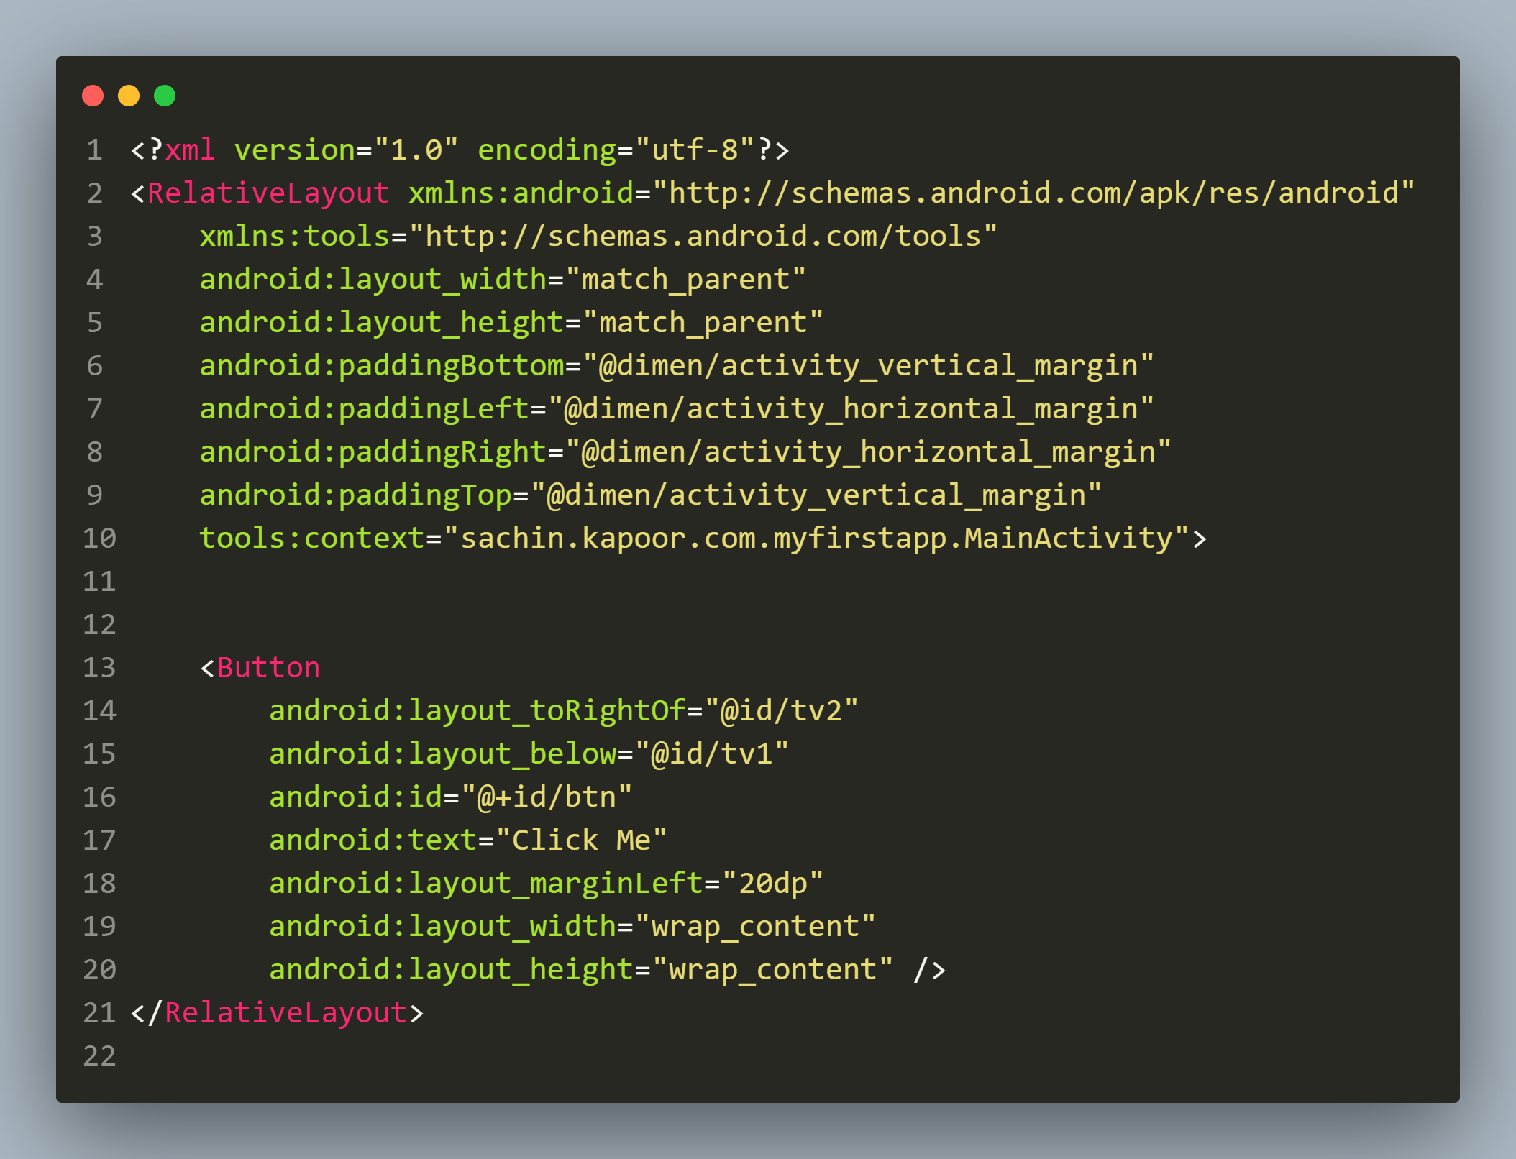
Android’s activity_main.xml

Slide 14
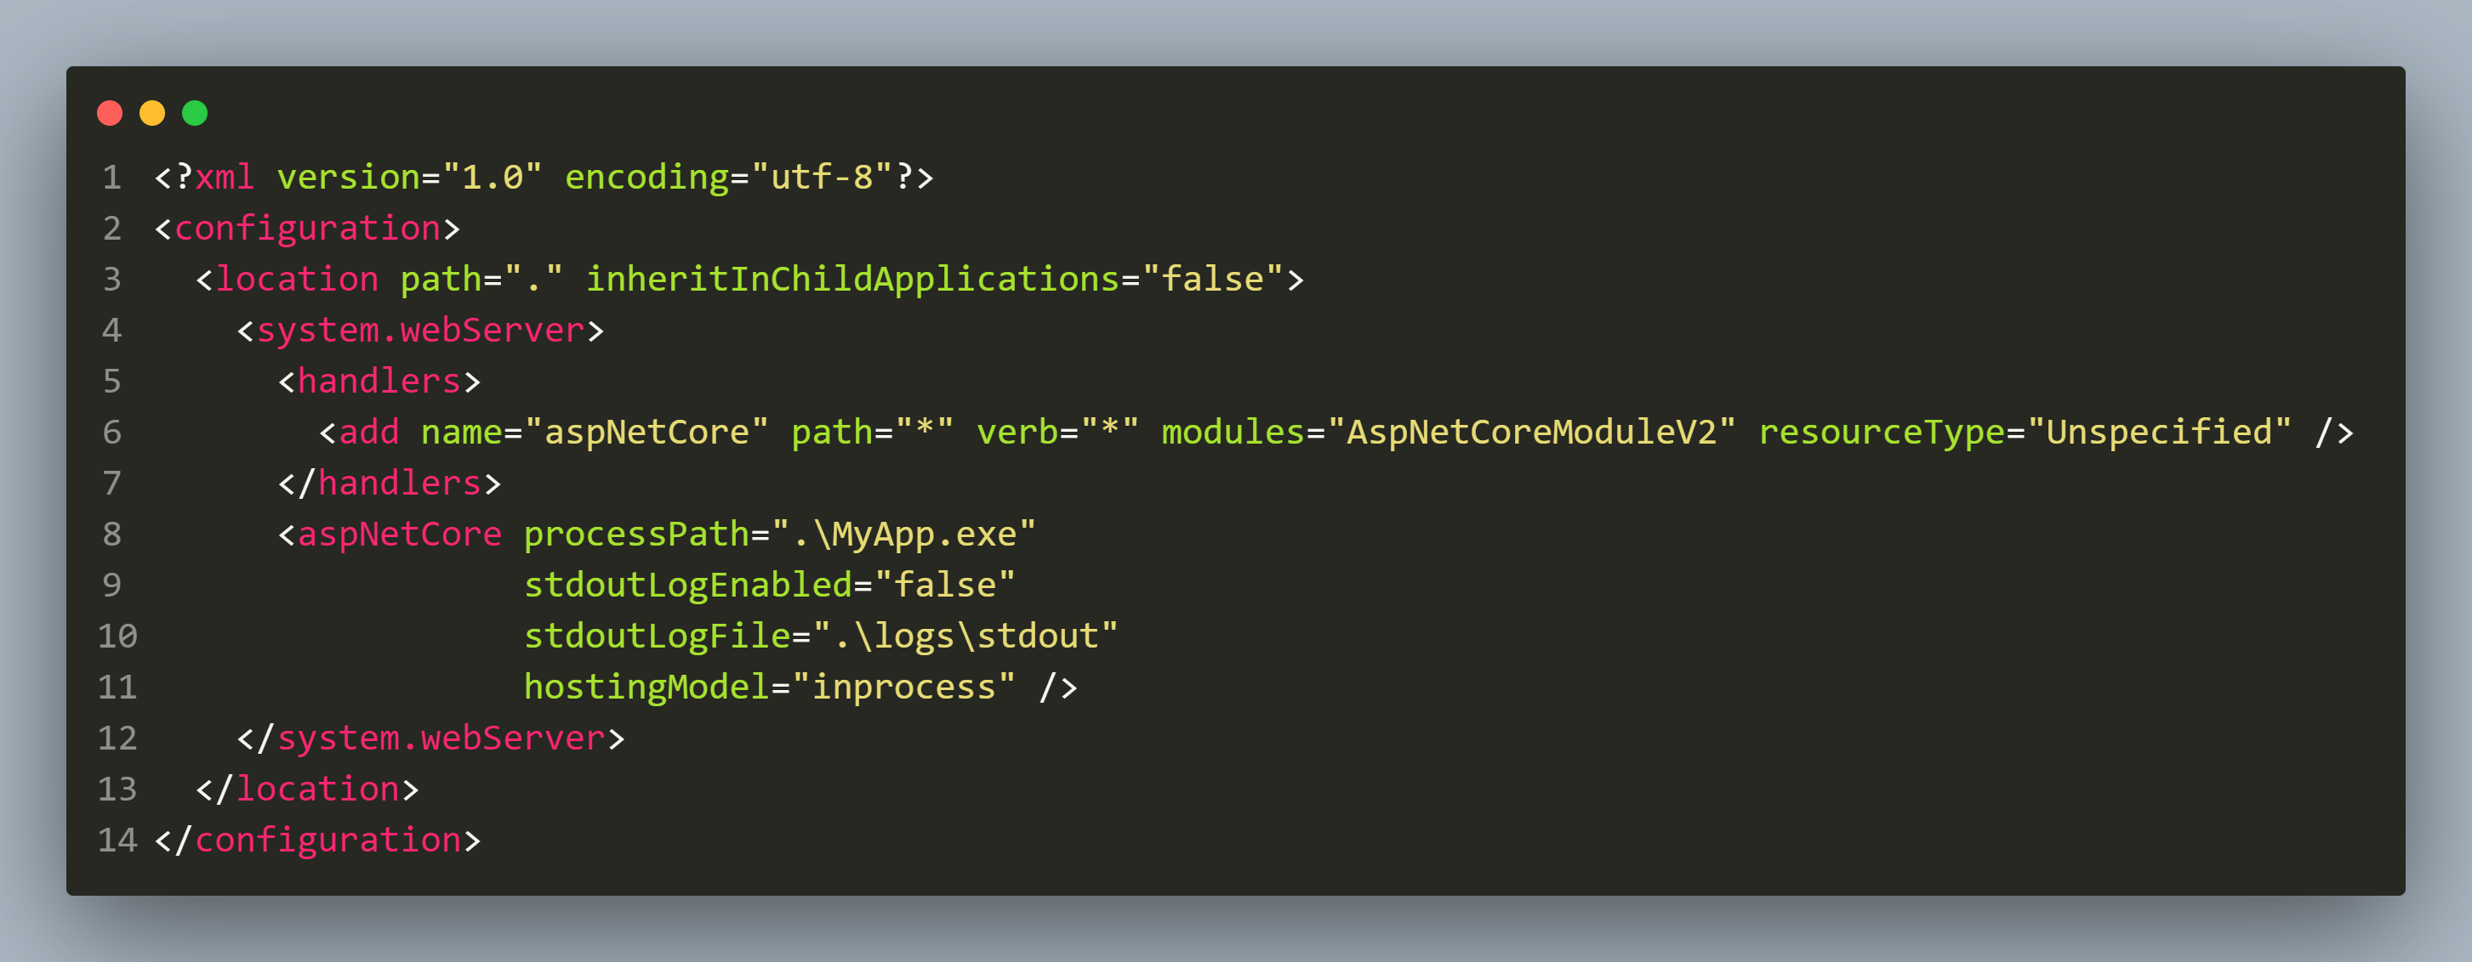
ASP.NET’s web.config.xml

Slide 15
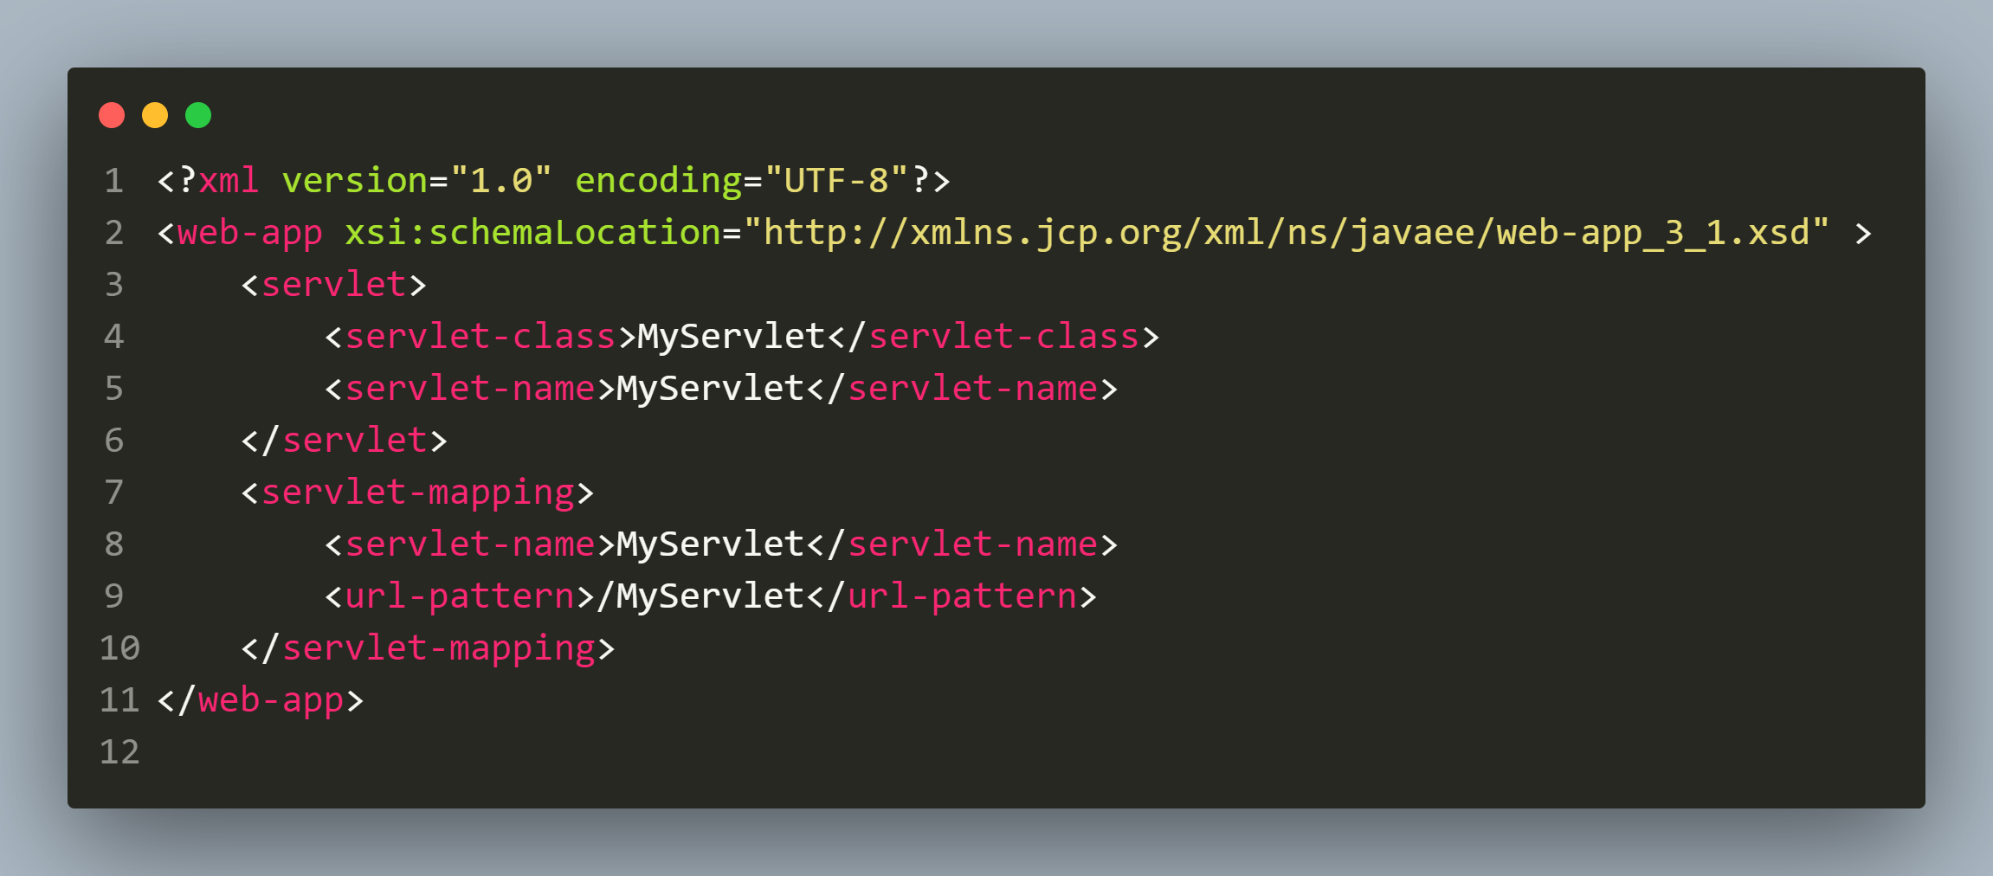
JEE Servlet’s web. xml

Slide 16
Common Rules Of XML
XML has 4 important rules which we must always remember irrespective of the technology/framework we are using :
All XML documents must contain one root element that is the parent of all other elements.
All XML elements must have a closing tag.
All XML tags are case sensitive.
All XML Attribute values must always be quoted.

Slide 17
Default Format Of Spring Configuration XML File
The Spring configuration file has the following structure/format :
Some Declarations
<beans> :This is the parent/root tag
<bean> : We only handle this tag
We can find this default format at:
https://docs.spring.io/spring-framework/docs/4.2.x/spring-framework-reference/html/xsd-configuration.html

Slide 18
Default Format Of Spring Configuration XML File
<?xml version="1.0" encoding="UTF-8"?>
<beans xmlns="http://www.springframework.org/schema/beans" xmlns:xsi="http://www.w3.org/2001/XMLSchema-instance" xsi:schemaLocation=" http://www.springframework.org/schema/beans http://www.springframework.org/schema/beans/spring-beans.xsd">
<!-- bean definitions here -->
</beans>

Slide 19
Our Spring Configuration File
<?xml version="1.0" encoding="UTF-8"?>
<beans xmlns="http://www.springframework.org/schema/beans"
xmlns:xsi="http://www.w3.org/2001/XMLSchema-instance"
xsi:schemaLocation="
http://www.springframework.org/schema/beans http://www.springframework.org/schema/beans/spring-beans.xsd">
<bean class="in.scalive.beans.Student" id="stdObj">
<property name="name" value="Amit"/>
<property name="rollno" value="101"/>
</bean>
</beans>

Slide 20
Understanding The <bean> Tag
The <bean> tag instructs the spring container to create object.
We require one bean tag per bean object to be created by spring container.

Slide 21
Understanding The <bean> Tag
The <bean> tag uses 2 attributes:
class: The fully qualified name of the bean class.
id: The name of the obj ref using which we will access the bean.
Example:
<bean class="in.scalive.beans.Student" id="stdObj">
Special Note: There are other attributes also like name , scope etc which we will discuss in upcoming lectures.

Slide 22
Understanding The <property> Tag
We can also instruct the spring container to initialize the bean object after creating it.
This is done by asking the container to automatically call the setter methods of that bean.

Slide 23
Understanding The <property> Tag
And to do this we use the <property> tag.
Thus we say that <property> tag is a way of implementing dependency injection using the SETTER INJECTION mechanism.

Slide 24
Understanding The <property> Tag
The <property> tag also uses 2 attributes:
name: This the field/data member name which has to be initialized.
value: The data to be passed for initialization.
Example:
<property name="name" value="Amit"/>
<property name="rollno" value="101"/>

Slide 25
Developing The Main Class
Our final step is to ask Spring to create bean object, initialize it and manage the dependencies for us.
This is done by starting the Spring IOC Container and these IOC Containers are of 2 types:
BeanFactory
ApplicationContext

Slide 26
Understanding The BeanFactory
The BeanFactory is an interface present in the package org.springframework.beans.
It is the core/base/root container that creates, initializes and manages all the bean objects for us.
It also provides dependency injection to Spring applications.

Slide 27
Instantiating BeanFactory
Since BeanFactory is an interface we cannot create its object .
So Spring has provided some predefined classes which have already implemented the BeanFactory interface.

Slide 28
Instantiating BeanFactory
One of the most popularly used implementation of BeanFactory is the XmLBeanFactory .
XmLBeanFactory allows the representation of objects and their dependencies in terms of XML.

Slide 29
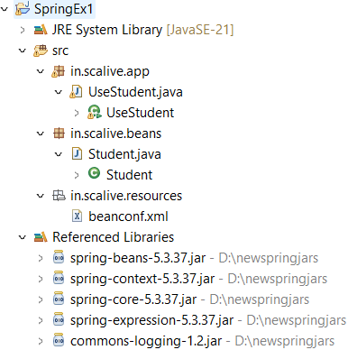
Folder Structure Of Our App

Slide 30
The Main Class
package in.scalive.app;
import org.springframework.beans.factory.BeanFactory;
import org.springframework.beans.factory.xml.XmlBeanFactory;
import org.springframework.core.io.ClassPathResource;
import org.springframework.core.io.Resource;
import in.scalive.beans.Student;
public class UseStudent {
public static void main(String[] args) {
Resource res=new ClassPathResource("/in/scalive/resources/beanconf.xml");
BeanFactory container=new XmlBeanFactory(res);
Student st=(Student)container.getBean("stdObj");
System.out.println("Name:"+st.getName());
System.out.println("Roll no:"+st.getRollno());
}
}

Slide 31
Output
OUTPUT
Creating Student object...
Initializing name...
Initializing rollno...
Name:Amit
Roll no:101

Slide 32
Understanding The Code
The XmlBeanFactory takes XML configuration metadata to create the fully configured application.
To use the BeanFactory, we need to create the object of XmlBeanFactory class as shown in the next slide.

Slide 33
Understanding The Code
Resource res=new ClassPathResource("/in/scalive/resources/beanconf.xml");
BeanFactory container=new XmlBeanFactory(res);
The constructor of XmlBeanFactory class receives the Resource object.
The XmlBeanFactory class then uses the configuration metadata mentioned in the XML file to load, assemble and dispense the beans upon request.

Slide 34
What Is Resource ?
Resource is a predefined interface available in the package org.springframework.core.io.
Whenever we need to load any external file ie. XML file , text file ,Image etc then we use Resource.
It has several implementation classes:
ClassPathResource
URLResource
ByteArrayResource
InputStreamResource

Slide 35
What Is getBean() ?
getBean() is a method available in BeanFactory interface and is overloaded with 5 versions.
The version we are calling has the following declaration:
public Object getBean(String name)

Slide 36
What Is getBean() ?
Whenever we require a Bean object from container we call this method passing it the name of the bean which is the id value we have set in the configuration file.
If a bean with given id value is present in the container this method returns that bean as an Object.
Otherwise it throws an exception called NoSuchBeanDefinitionException

Slide 37
2nd Version Of getBean()
getBean() has another overloaded version which has the following prototype:
public T getBean(Class)
This method accepts the name of .class file as argument and returns us the bean object of that class.

Slide 38
2nd Version Of getBean()
Question ?
What is T ?
Answer
T is a generic name which gets converted to exact class type which is passed as argument.
For example if we pass Student.class as argument then T will become Student and we will get back a Student object.
Example:
Student s=container.getBean(Student.class);

Slide 39
The Main Class
package in.scalive.app;
import org.springframework.beans.factory.BeanFactory;
import org.springframework.beans.factory.xml.XmlBeanFactory;
import org.springframework.core.io.ClassPathResource;
import org.springframework.core.io.Resource;
import in.scalive.beans.Student;
public class UseStudent {
public static void main(String[] args) {
Resource res=new ClassPathResource("/in/scalive/resources/beanconf.xml");
BeanFactory container=new XmlBeanFactory(res);
Student st=container.getBean(Student.class); // We are now calling 2nd ver of getBean()
System.out.println("Name:"+st.getName());
System.out.println("Roll no:"+st.getRollno());
}
}

Slide 40
Output
OUTPUT
Creating Student object...
Initializing name...
Initializing rollno...
Name:Amit
Roll no:101

Slide 41
Switching To ApplicationContext
As mentioned before the Spring IOC Containers are of 2 types:
BeanFactory
ApplicationContext
We have discussed BeanFactory and XmlBeanFactory , so now lets rewrite the UseStudent class using ApplicationContext.

Slide 42
Understanding ApplicationContext
ApplicationContext also an interface available in the package org.springframework.context.
It inherits from the BeanFactory interface and thus includes all the functionality of BeanFactory and adds some new functionality also.
It is new and modern container and is preferred over BeanFactory due to several reasons which we will discuss later.

Slide 43
Implementation Classes Of ApplicationContext
The most popularly used ApplicationContext implementations are:
ClassPathXmlApplicationContext :This container loads the definitions of the beans from an XML file.
XmlWebApplicationContext : This container loads the XML file with definitions of all beans from within a web application.
AnnotationConfigApplicationContext : This container loads the definitions of the beans from an .class file.

Slide 44
Modified Main Class
package in.scalive.app;
import org.springframework.context.ApplicationContext;
import org.springframework.context.support.ClassPathXmlApplicationContext;
import in.scalive.beans.Student;
public class UseStudent {
public static void main(String[] args) {
ApplicationContext container=new ClassPathXmlApplicationContext("/in/scalive/resources/beanconf.xml");
Student st=(Student)container.getBean("stdObj");
System.out.println("Name:"+st.getName());
System.out.println("Roll no:"+st.getRollno());
}
}

Slide 45
Output
OUTPUT
Creating Student object...
Initializing name...
Initializing rollno...
Name:Amit
Roll no:101

Slide 46
BeanFactory V/s ApplicationContext
BeanFactory | ApplicationContext
It is a fundamental container that provides the basic functionality for managing beans. | It is an advanced container that extends the BeanFactory that provides all basic functionality and adds some advanced features.
Since BeanFactory provides basic features only thus requires less memory. | ApplicationContext provides all the basic and advanced features, and thus requires more memory.
It is suitable to build standalone applications. | It is suitable to build Web applications, ORM and distributed applications.
Performs Lazy initialization. | Performs Eager initialization , but for beans with scope value singleton and not prototype.

Slide 47
Some Advance Differences
BeanFactory | ApplicationContext
It supports only Singleton and Prototype bean scopes. | It supports all types of bean scopes such as Singleton, Prototype, Request, Session etc.
BeanFactory does not support Event publication functionality. | Event handling in the ApplicationContext is provided through the ApplicationEvent class and ApplicationListener interface.
It does not support Annotations. | It supports Annotation based configuration

